Slide 1
Chapter 10 Generics
FALL 2021

Slide 2
Objectives
Create generic methods that perform identical tasks on arguments of different types.
Create a generic class that can be used to store objects of any type.
Understand how to overload generic methods with non-generic methods or with other generic methods.
Understand raw types and how they help achieve backwards compatibility.

Slide 3
Introduction
Generics
New features of J2SE 5.0
Provide compile-time type safety
Catch invalid types at compile time
Early detection of type violations
Hides automatically generated casts

Slide 4
Motivation for Generic Methods
Overloaded methods
Perform similar operations on different types of data
Overloaded printArray methods
Integer array
Double array
Character array
Only reference types can be used with generic methods and classes

Slide 5
Motivation for Generic Methods
A slightly better version:
You can take advantage of polymorphism and use a version based on java.lang.Object, however:
There is a need to insert the appropriate cast
Which gives a risk of getting ClassCastException (runtime exception)

Slide 6
Type Parameter
Generic method declaration
Type parameter section
Delimited by angle brackets (<>)
Precedes the method’s return type
Used to declare return type, parameter types and local variable types
Any non-keyword identifier can be used for the type parameter, but by convention, the parameter starts with an uppercase letter.
The type parameter can be used like other types used in the definition of a generic method.
Multiple type parameters are listed in angular brackets just as in the single type parameter case but are separated by commas.
Example: <T, U, F>

Slide 7


Limitations of type parameter usage
Within the definition of a parameterized class definition, there are places where an ordinary class name would be allowed, but a type parameter is not allowed.
In particular, the type parameter cannot be used to create a new object
For instance, the type parameter cannot be used as a constructor name or like a constructor
Instead, use:

Slide 8
Common Programming Error
When declaring a generic method, failing to place a type parameter section before the return type of a method is a syntax error – the compiler will not understand the type parameter name when it is encountered in the method.

Slide 9
Compile-Time Translation
Compile-time translation
Erasure
Remove type parameter section
The compiler will replace all occurrences in the class type parameter with the upper bound of the formal parameter
The default upper bound in the class java.lang.Object
Type casts are introduced as necessary
The produced byte code does not use generics
Compiler performs type checking
Compile time safety (compiler is able to prevent runtime cast errors, e.g., ClassCastException)

Slide 10
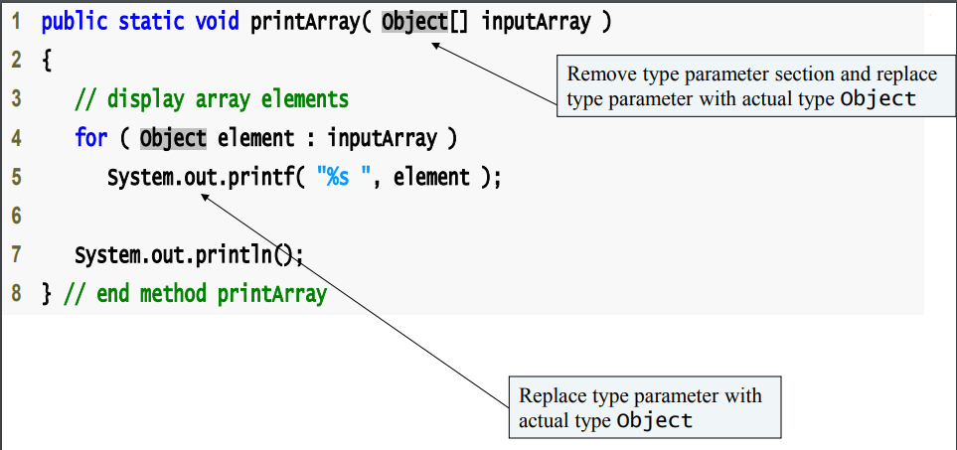

Slide 11
Upper bound of type parameter
Upper bound of type parameter
Sometimes we want restricted parameterization of classes or methods
Actually, all type parameters are replaced by the upper bound of the type parameter
Unless specified, java.lang.Object is the upper bound by default
To indicate the upper bound follow the type’s parameter name by the keyword extends followed by the class or interface name that represents the upper bound.

Slide 12
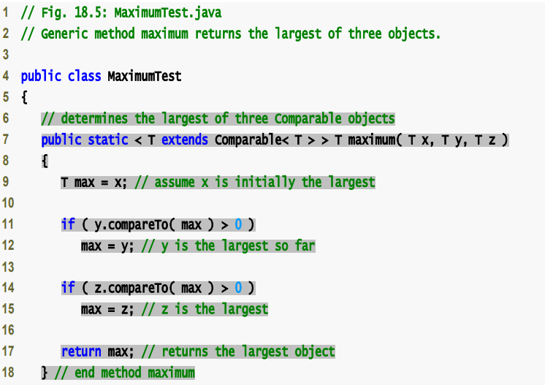

Slide 13
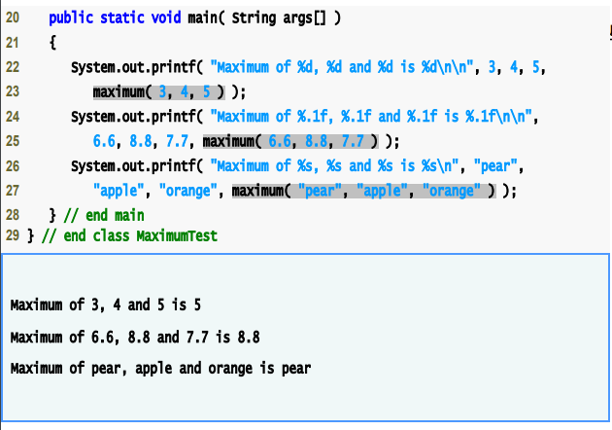

Slide 14
Additional Compile-Time Translation Issues: Upper bound of type parameter
When compiler translates generic method to Java bytecode.
Replaces type parameter with its upper bound
Insert explicit cast operation
E.g., line 23 of the previous figure, I preceded by an Integer cast (Integer) maximum (3, 4, 5)

Slide 15
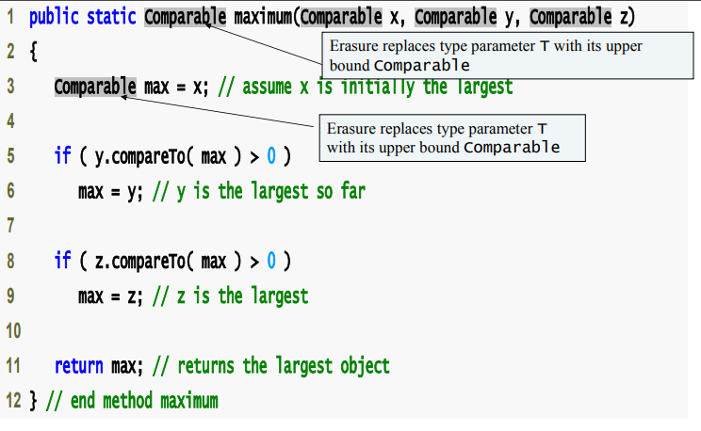

Slide 16
Programming Error
A primitive type cannot be plugged in for a type parameter.
It cannot be a primitive type such as int, double, or char.
However, with automatic boxing of wrapper types, this is not a big restriction.

Slide 17
Overloading a Generic Method
Generic method may be overloaded
By another generic method
Same method name but different method parameters
By non-generic methods
Same method name and number of parameters
When compiler encounters a method call
Search for most precise matching method first
Exact method name and argument types.
Then search for inexact but applicable matching method

Slide 18
Generic Classes
Generic class declaration
Looks like a non-generic class declaration
Except class name is followed by a type parameter section
E.g., Stack <T>
Generic Classes
Use a simple, concise notation to indicate the actual type (s)
At compilation time, Java compiler
Ensures the type safety
Uses the erasure technique to enable client code to interact with the generic class
Parameterized Types
E.g., Stack<Double>

Slide 19
Generic Classes
Generic class at compilation time
Compiler performs erasure on class’s type parameters:
Compiler replaces type parameters with their upper bound
Generic class test program at compilation time
Compiler performs type checking:
Compiler inserts cast operations as necessary

Slide 20
Raw Types
Raw type
It is occasionally necessary to refer to a parameterized type stripped of its parameters, which we call a raw type.
Enables to instantiate generic class without specifying a type argument
E.g., Stack objs = new Stack(5);
A raw type Stack variable can be assigned to a Stack that specifies a type argument.
e.g., Stack objs = new Stack <Integer> (5);
A Stack variable that specifies a type argument can be assigned a raw type Stack
Permitted but unsafe
E.g., Stack <Integer> objs = new Stack(5);

Slide 21
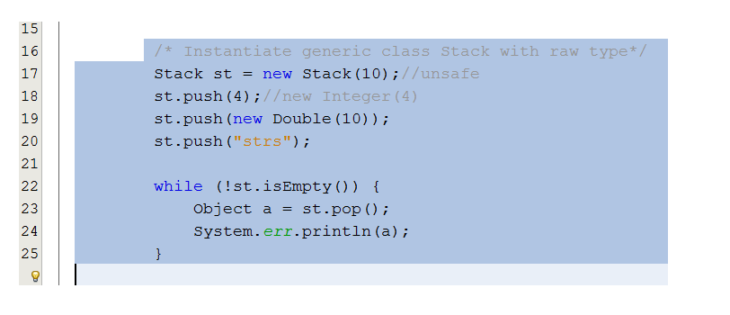
Raw types – Example 1

Slide 22
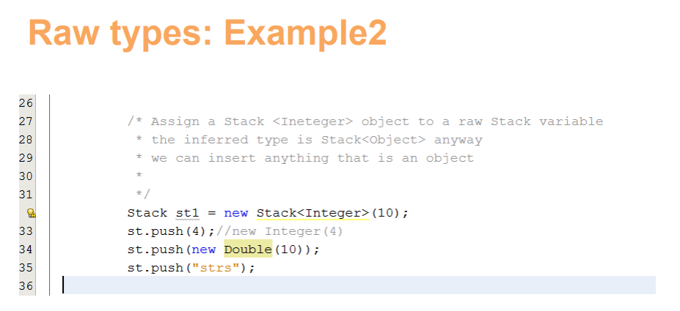
Raw types – Example 2

Slide 23
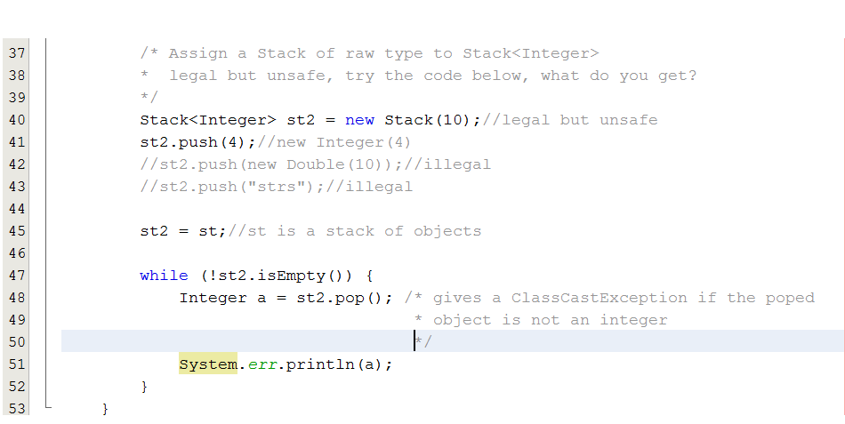
Raw types – Example 3

